Slide 1
IM Residency
Interviewing for Fellowship Workshop
General overview
Special considerations for us
Group discussion

Slide 2
How do programs rank you? Survey of Program Directors
Survey of 1,088 Fellowship Program Directors (response rate of 52%)
“What applicant attributes are most important to you?”

Slide 3
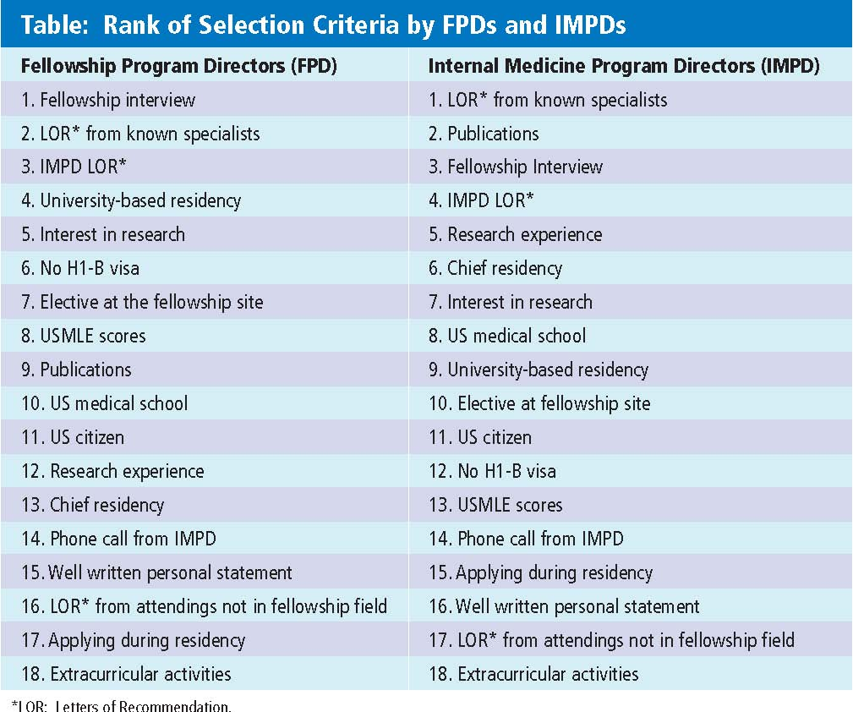
All specialties are not the same
Priorities different for:
  Competitive Procedural
  Cognitive
  Dual/mixed Programs

Slide 4
Interview Preparation
Scholarship the program: Internet, author searches, brochures, personal contacts
Research the location to avoid surprises
Self-analysis: strengths, areas for improvement
Think of questions to ask:
  avoid topics addressed by brochure or welcoming session
  Use to convey interests

Slide 5
At the Interview
Listen to all questions carefully and think through your answers
Don’t stray too far from the question
Express interest in academic medicine
Be concise
Be enthusiastic

Slide 6
At the interview…
Sell yourself…modestly
avoid ambiguity or indecisiveness
scholarship-all programs want scholars!
Anticipate 4 questions
    A ‘conversation starter’
    - “how were your travels?” or “first time here?” or “tell me about Mayo”
    “Why did you apply here?” (interest level)
    “What are your goals?” (scholarship)
    “Strengths? Weaknesses?”
Notes:
Show passion for the field, not passion for power…”I want to be NIH funded scholarshiper to advance the field of X” better than “I want to be department chair…”

Slide 7
Common Interview Questions
Tell me about your scholarship project
What quality will distinguish you from other applicants?
What areas can you improve upon?
Why are you interested in ___? This program?
Tell me about a challenging moment/case
What do you like/dislike most about your residency program
Where do you see yourself in ten years?
Do you have any questions?

Slide 8
Where does scholarship fit into your training and career plans?

Slide 9
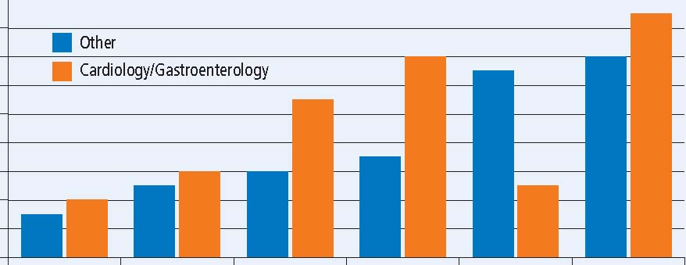
Comparison of Ranked Selection Criteria by Subspecialty- Cardiology and Gastroenterology versus Other Subspecialties
18
16
14
12
10
8
6
4
2
0
Cardiology/Gastroenterology
Other
University scholarship Publications scholarship Elective Current
Residency Interest Experience Resident
Notes:
Lower is more important (rank of 1 is most important) … Key is reversed in article !! (see article) Corrected with text-boxes in slide…fsm

Slide 10
Interviews
You are competing against outside applicants
  They are on their best behavior for interview
  Blemishes are less apparent
  Their adrenaline is flowing
Pitfalls for residents:
  Too familiar, too casual, too confident
Sell yourself: as if interviewing elsewhere

Slide 11
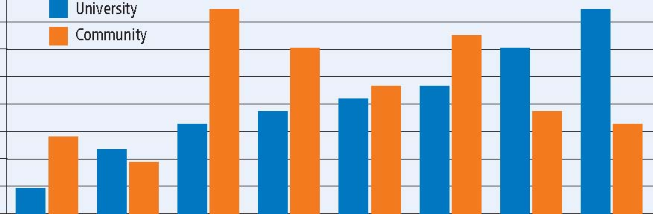
Ranked Selection Criteria by Fellowship Setting-
University versus Community
18
16
14
12
10
8
6
4
2
0
University scholarship No H-1B LCME scholarship US Citizen Elective Program
Residency Interest Experience Director Contact
Notes:
Note, PD contact is the least important factor for academic programs.

Slide 12
Assessing the Program
Be tactful, but reasonable to ask about
Available scholarship projects
What happened to graduating fellows
Procedures
Faculty attention
Board pass rates
Job opportunities
However, make sure this information hasn’t already been provided!

Slide 13
Special considerations for Interviews
“New Program”
The Southwest Indiana Internal Medicine Residency Program is an academic program sponsored by Indiana University, which serves a large catchment area including southwest Indiana, northern Kentucky, and southeast Illinois. Ours is a multihospital program, with over 600 faculty physicians. Our educational mission is to train physicians to care for medically complex patients in rural environments. To facilitate that mission, our residents have intense inpatient and outpatient clinical experiences, which far exceed the minimum requirements, as well as longitudinal training in quality safety, operational excellence, and procedural competence to allow them to excel in resource poor rural health care environments. All our residents are required to lead annual scholarly projects in at least one of the key areas of competency necessary for a career in rural health care.

Slide 14
Special considerations for Interviews
Letters
  Experienced writers
  Gravitas in the specialty
  Ask writer if they can write a competency based letter
Scholarship
  Published – best
  Submitted - ok
  In prep – be prepared to describe

Slide 15
Post Interview
Letter to fellowship director:
  Appreciation for hospitality
  Strengths of their program
Letter to potential advocates
Maintain a running rank list
Rank programs in order of YOUR preference

Slide 16
Post Interview
Tell first choice your ranking them #1
Be honest (don’t claim above unless you mean it)
Be prepared for calls from programs
  Outside-the-match offers
  Ask you for your rank order preference
  “Can I have a week to talk to my spouse/PD.”
Notes:
Other things to discuss:
Be nice to the secretary
Don’t be high maintenance
Beware of your “electronic” personality

